Slide 1
Principles of Data Science
Li Niu

Slide 2

Singular Value Decomposition (SVD)
The SVD is the Swiss Army knife of matrix decompositions
—Diane O’Leary, 2006

Slide 3
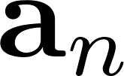
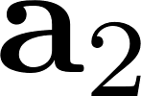
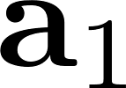



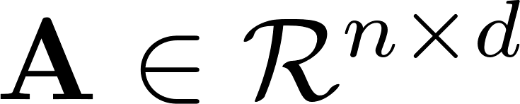

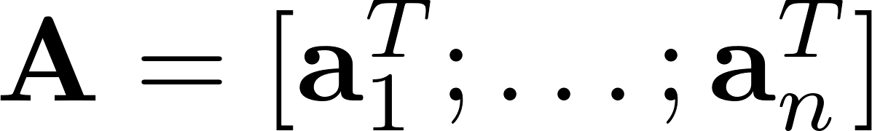
Singular Value Decomposition (SVD)
….
: distance
: projection
Matrix represent points in -dim space:
is a line in -dim space.

Slide 4
Singular Value Decomposition (SVD)
….
: distance
: projection
Best fitting line: maximize the sum of squared projections of points to this line

Slide 5
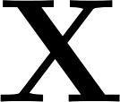

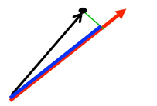
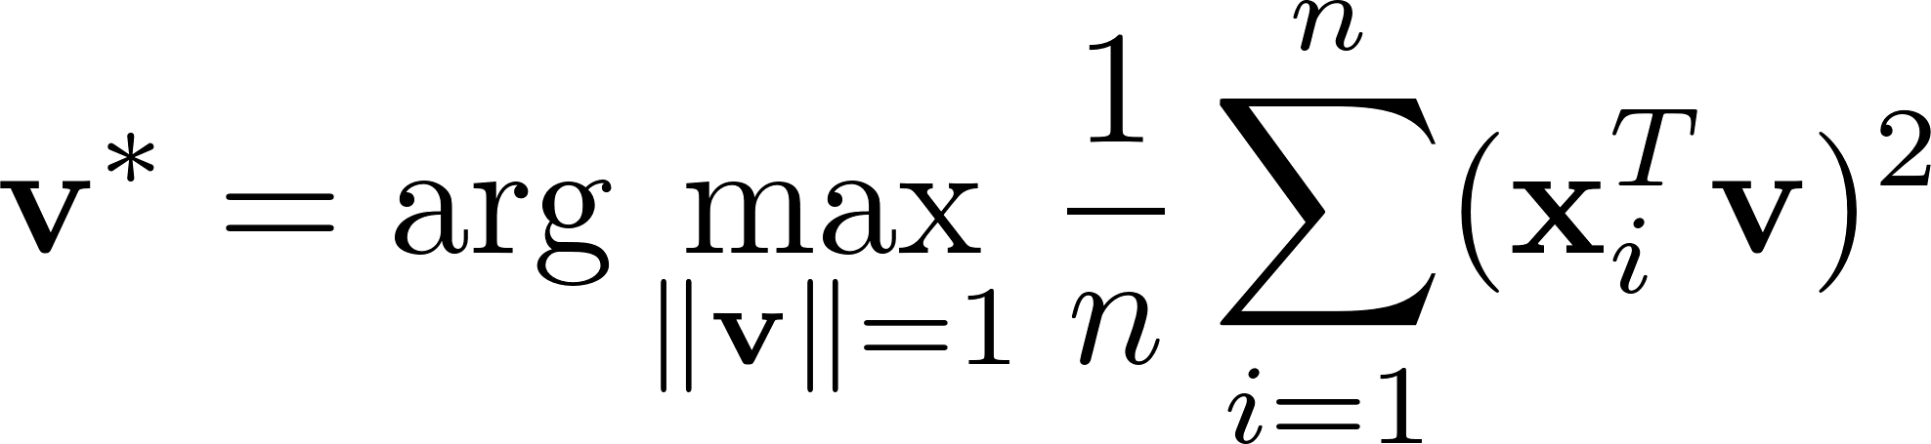
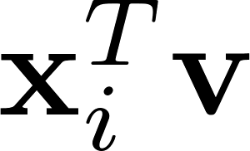
Singular Value Decomposition (SVD)
Recall PCA:
Maximum variance direction: when is decentralized

Slide 6
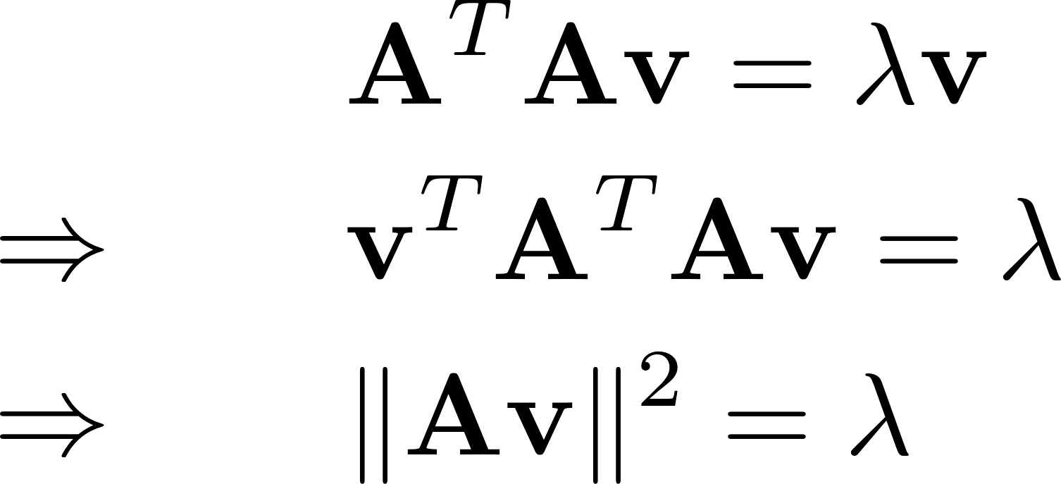
Singular Value Decomposition (SVD)
Relation to Eigen Decomposition:

Slide 7
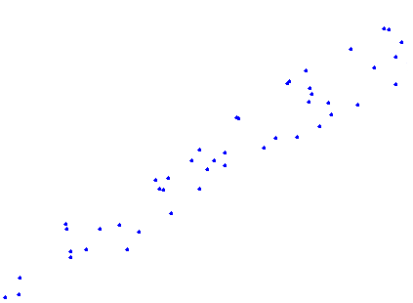
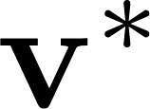
Singular Value Decomposition (SVD)
maximize the sum of squared projections of points to this line

Slide 8
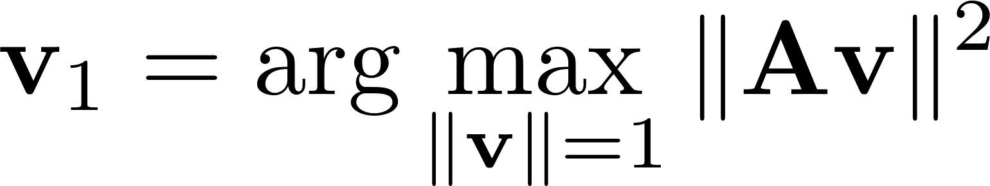
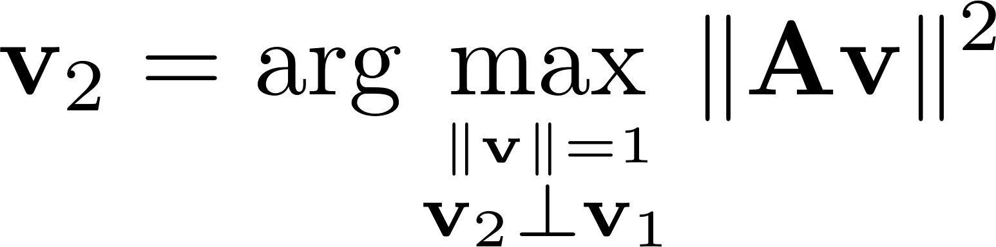

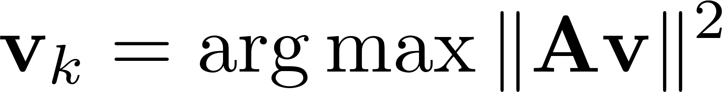
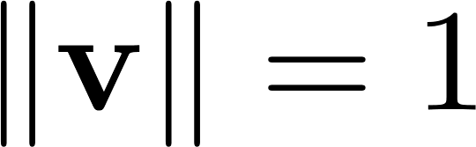
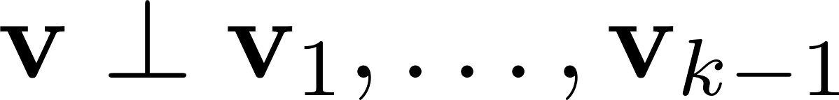

Singular Value Decomposition (SVD)
Subspace: a set of orthogonal best fitting lines.
….

Slide 9
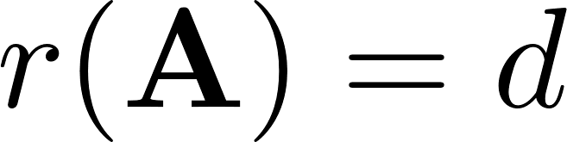
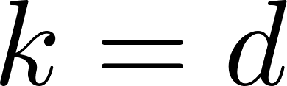
Singular Value Decomposition (SVD)
Subspace: a set of orthogonal best fitting lines.
….
When , stop at

Slide 10
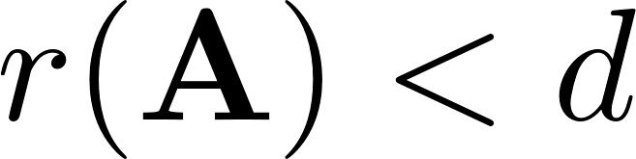
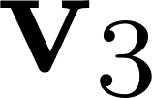
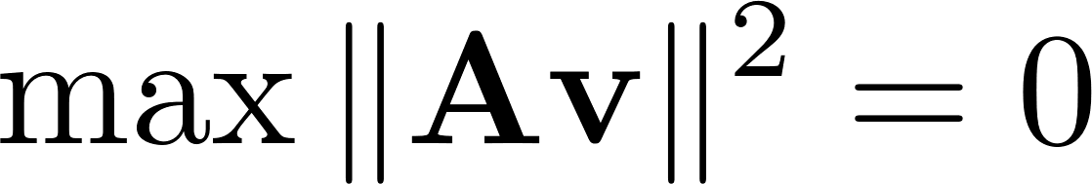
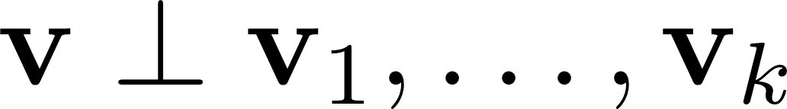
Singular Value Decomposition (SVD)
Subspace: a set of orthogonal best fitting lines.
….
When , reach null space ( perpendicular to and )

Slide 11
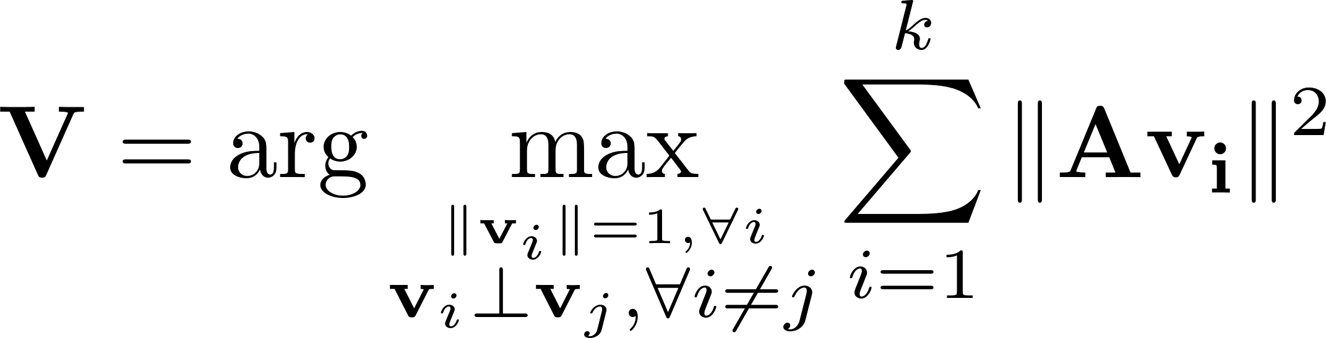
Singular Value Decomposition (SVD)
Subspace: a set of orthogonal best fitting lines.
….
This is greedy algorithm, but can find the global optimum

Slide 12
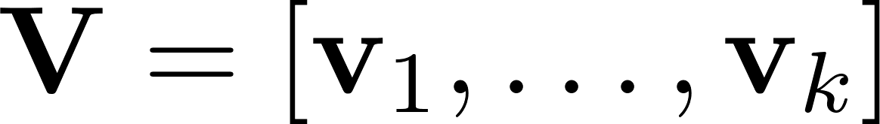
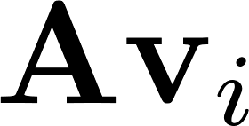
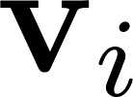
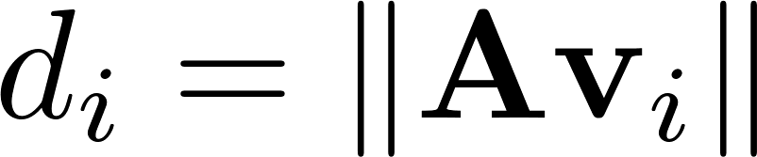
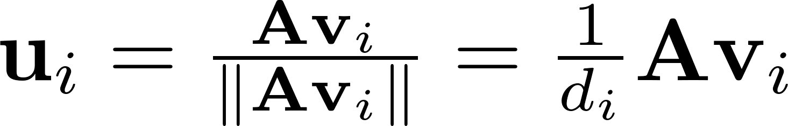
Singular Value Decomposition (SVD)
….
: distance
is projection direction
: projection
: projection of on
: norm of projection
: normalized projection

Slide 13
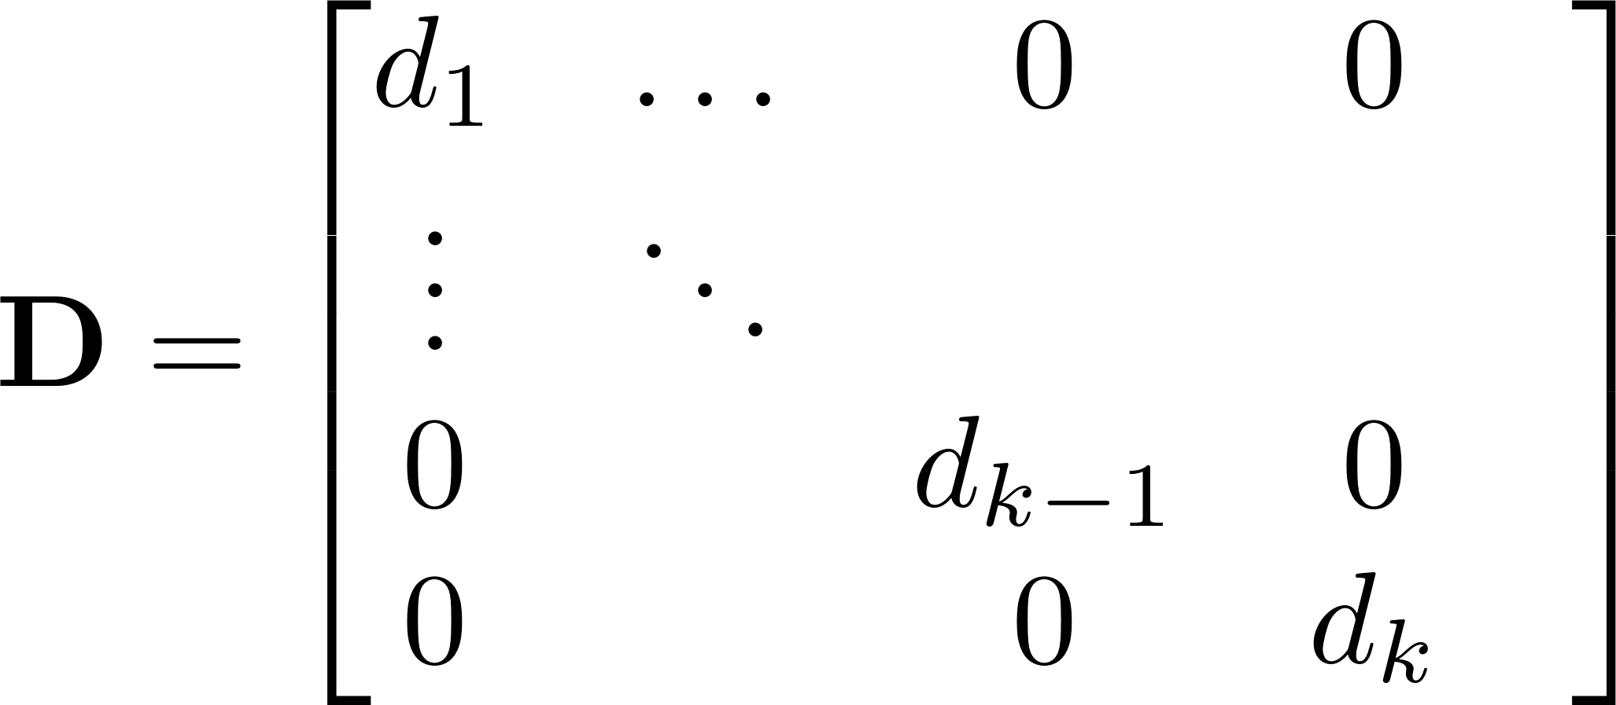
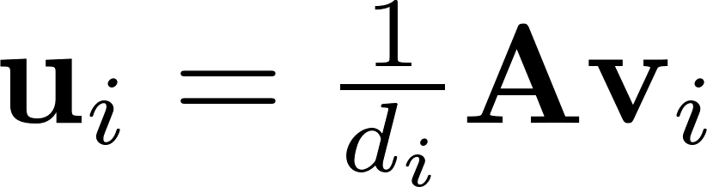
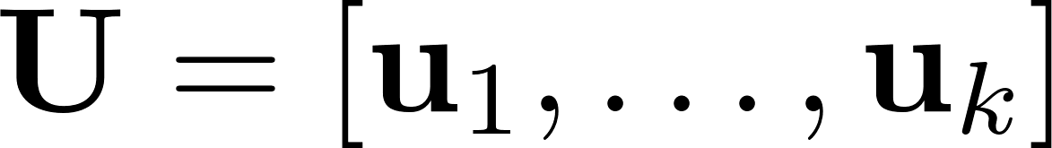
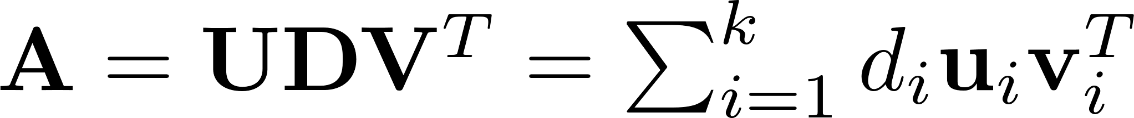
Singular Value Decomposition (SVD)
is projection direction
: norm of projection
: normalized projection
It can be proved that

Slide 14
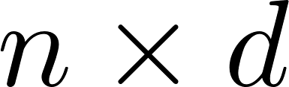

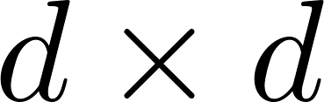

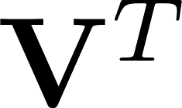
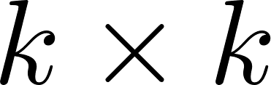
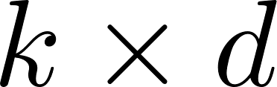
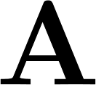

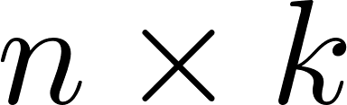

Singular Value Decomposition (SVD)
left singular vectors
singular values
right singular vectors
The rank of is , the number of non-zero singular values.
The positive definite matrix has all positive singular values.

Slide 15

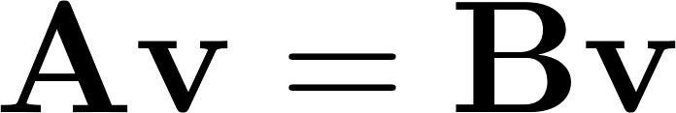
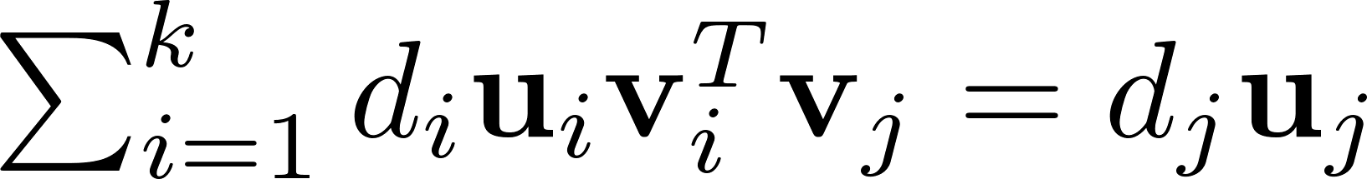
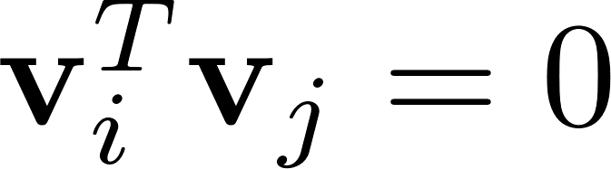
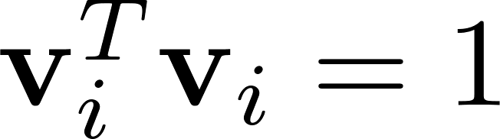
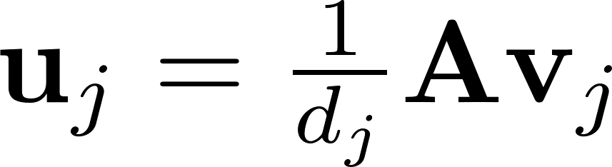
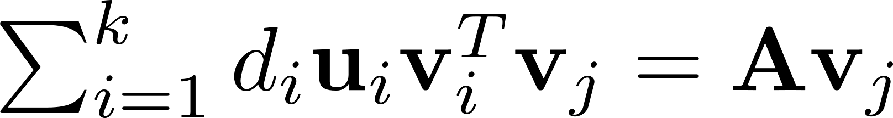
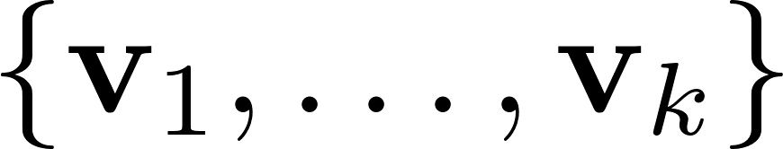

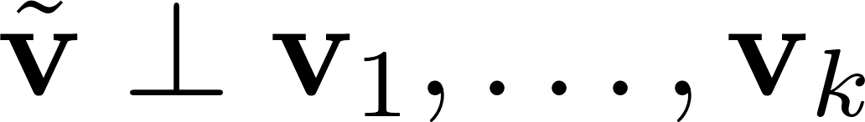
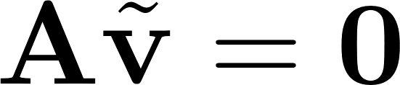
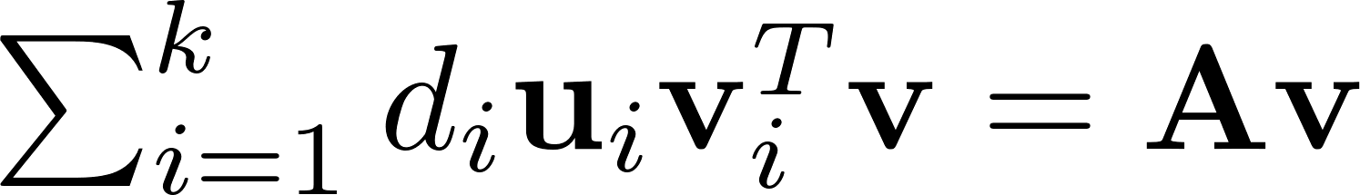

Proof
Lemma : Matrices and are identical if and only if for all vectors ,
Theorem:
Proof:
considering and
Any can be represented by a linear combination of and in the null space, i.e., and
Therefore, for any
Lemma

Slide 16








Norm based on SVD
: rank of
: nuclear norm
: Frobenius norm
: spectral norm

Slide 17






Application of SVD: rank-k approximation
is a rank-k matrix that is the closest rank-k matrix to the original matrix
Step1:
Step2:
Step3:
Change to by setting singular values to 0.

Slide 18


Application of SVD: image compression
Compress an image of size , the same as rank-k approximation.
Original size:
Compressed size:

Slide 19






Application of SVD: image compression
When , compression factor is
original image

Slide 20








Application of SVD: least square
Solution:
pseudo inverse
Proof:
because
By denoting , the solution to is

Slide 21









Slide 22

Application of SVD: latent semantic analysis
: term-document matrix

Slide 23



Application of SVD: latent semantic analysis
: term-topic matrix
two latent topics
: topic weights
: topic-document matrix

Slide 24


Application of SVD: latent semantic analysis
: term-document matrix
: topic-document matrix

Slide 25
Thanks!

